Slide 1
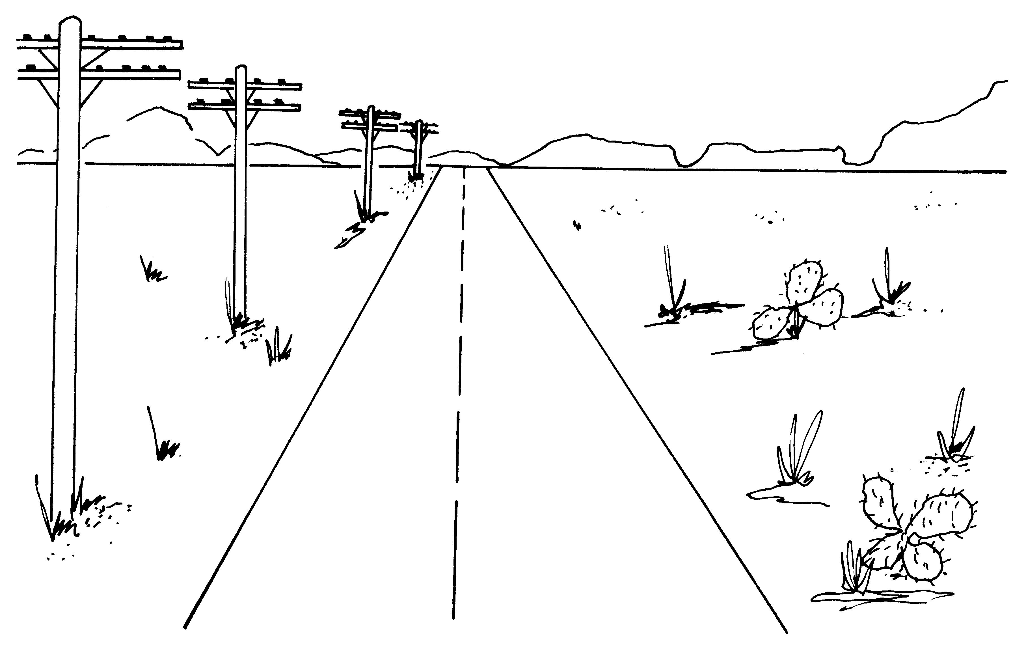
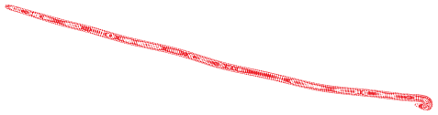

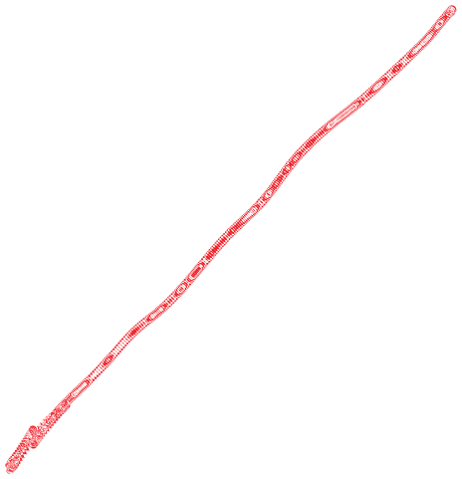

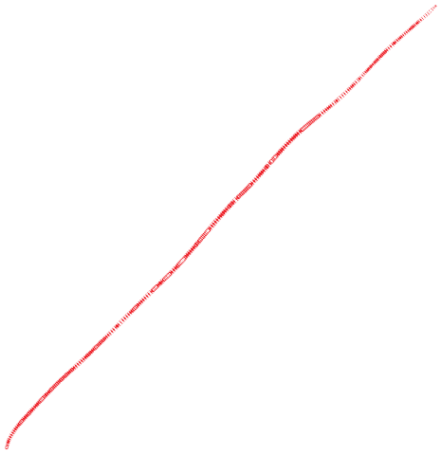
Parallel lines converge to a vanishing point

Slide 2
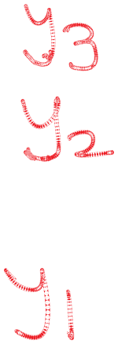
Nearer objects are lower in the image

Slide 3

Proof
The equation of the ground plane is Y = -h
A point on the ground plane will have y-coordinate y= -fh/Z

Slide 4

Nearer objects look bigger
Bottom at (X, - h, Z)
Top at (X, L – h, Z)
Height of object = L

Slide 5
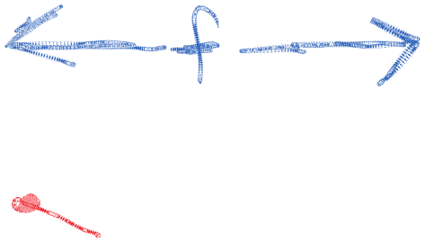

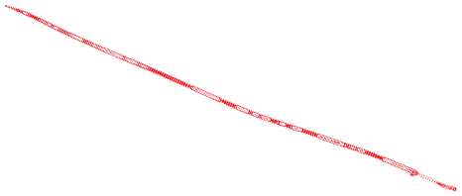





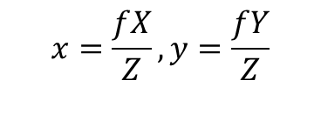
A projection model that avoids inversion
Perspective projection is a mapping from points in 3D space to rays through the Center of Projection

Slide 6
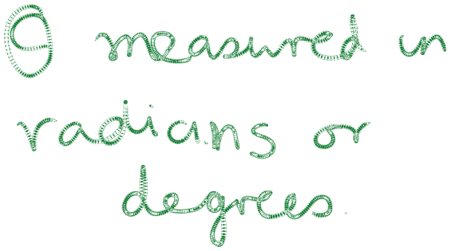

The natural measure of image size is visual angle
Perspective projection is a mapping from points in 3D space to rays through the Center of Projection

Slide 7
The natural measure of image size is visual angle
The human head is 9 inches high. At a distance of 9 feet, it subtends 1/12 radians=4.8 degrees.

Slide 8
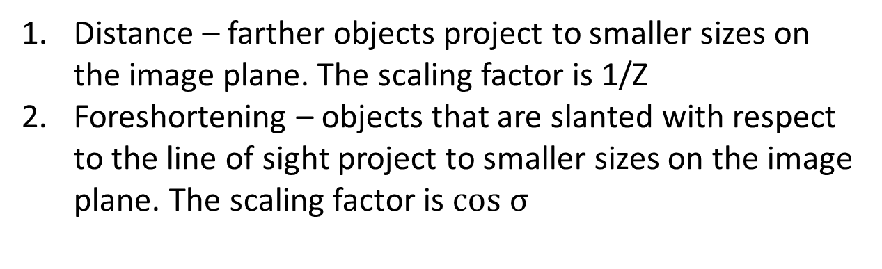
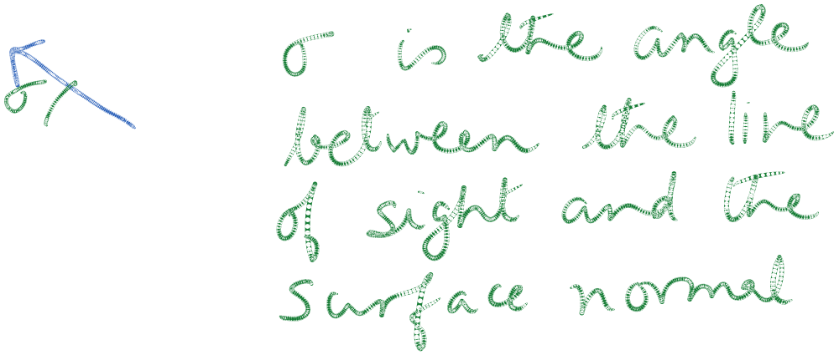
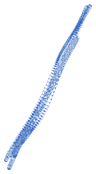

Two main effects of perspective projection

Slide 9
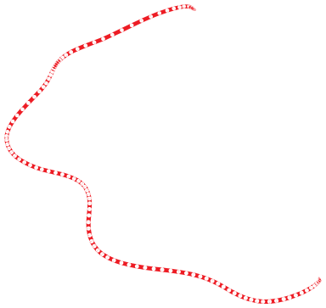
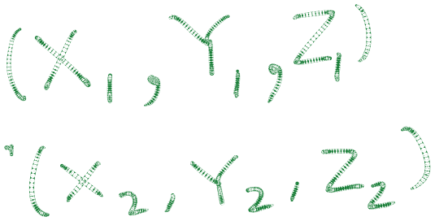
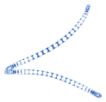
Orthographic projection
Approximation to perspective when the object is relatively far away
compared to the depth variation in it

